Slide 1

Gill Harrison
CASE Committee member, lead accreditor, education lead
Associate Professor & Ultrasound Programme Director. City, University of London

Slide 2

Aims
Explain the role of CASE & set the context
Give an overview of the changes within HEE that will impact on the work of CASE
Activity: focused v traditional courses
Explore the challenges as new educational options are developed in the UK

Slide 3

What is CASE?
Consortium for the Accreditation of Sonographic Education
‘Consortium’ = a group of companies or people with the same goal who are working together to achieve that goal (Cambridge English Dictionary)
Notes:
Primary role is to accredit high quality programmes/courses that
Promote best practice
Ensure U/S practitioners safe and competent
Taking into account informed views of service needs
Made up of 6 Mos who set the direction of CASE and support CASE committee
Mos – strategic direction and policy
CASE committee has 3 members from each MO – to allow 2 to attend each meeting

Slide 4
CASE principles
Reporting should not be separated from scanning
Assessment and interpretation of save imaged = sub-optimal practice. Deficiencies cannot be rectified post-scan
Dual reporting can help increase specificity
Need for competence at the point of scanning is paramount
Workforce modelling & innovative training routes should increase ‘efficiency of provision and effectiveness in delivery of diagnosis and treatment to patients’
Notes:
1. Reporting should not be separated from scanning;
2. Scanning is a ‘dynamic’ investigation in which the acquisition of suitable images and assessment of them is entirely operator-dependent at the time of the scan. Deficiencies in acquisition cannot be rectified by involving a more skilled practitioner at a later stage. Assessment and interpretation of saved images is recognised as sub-optimal practice although, as with all image interpretation, dual reporting can be helpful in increasing specificity;
3. The risk of patient harm and consequent litigation against any healthcare organisation providing a poor quality service is very high and therefore the need for competence at the point of scanning is paramount;
4. Workforce modelling and the development of innovative training routes to meet the demand for sonography services should demonstrate increased efficiency of provision and effectiveness in delivery of diagnosis and treatment to patients.

Slide 5
Challenges ahead for CASE?
Focused v programme
Differentiation
Not short cut
Voluntary roles. Consistency
CASE committee
Training
New entry pathways
Direct entry Ug
Direct entry Pg
Notes:
The challenges are differentiating between focused course and a Pg programme
Sometimes there is an overlap between the two and it can be hard to differentiate between them
New focused courses are being suggested all the time and the needs of clinical departments are evolving, so it’s a movable ‘beast’
It’s important to ensure that focused courses are not a short cut to a full ultrasound qualification. Physics is taught to a level to be competent in that very specific focused area of practice. Unless it’s a modular focussed course the credits cannot be transferred into a programme.

Slide 6
HEE’s mandate objective
“ensure that the NHS has available the right number of trained staff to deliver current and future demand for diagnostic tests… ensure sufficient numbers of suitably qualified sonographers to maintain ultrasound services”
DH (2016) Delivering high quality, effective, compassionate care: Developing the right people with the right skills and the right values. A mandate from the Government to Health Education England: April 2016 to March 2017

Slide 7
HEE project: stakeholders said
Need to develop new training models
Need sustainable supply of appropriately trained & supported sonographers for future
Career structure has to be developed to support regulation of sonography as a profession
Can’t carry on as we are

Slide 8
HEE and stakeholders
HEE work streams
Integrated Imaging workforce development group
SSG
Sonography steering group
Working groups
SIG
STG
Regulation
NOS

Slide 9
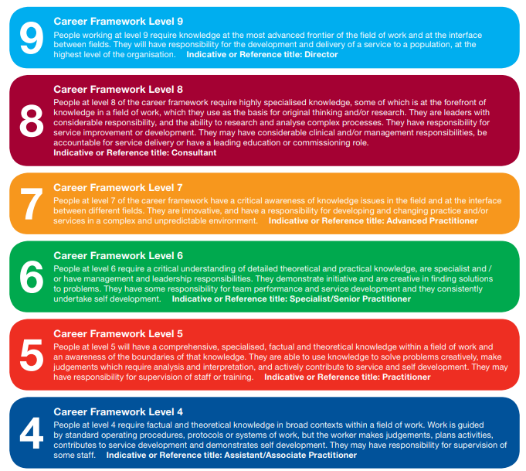
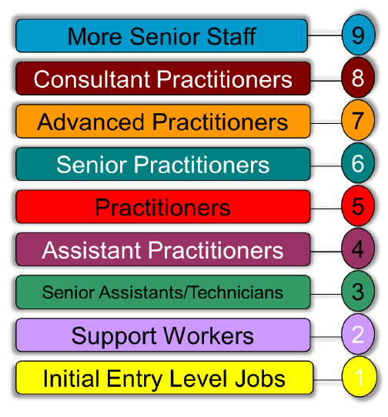
A Career Framework for the NHS (2004)
http://www.skillsforhealth.org.uk/index.php?option=com_mtree&task=att_download&link_id=163&cf_id=24

Slide 10
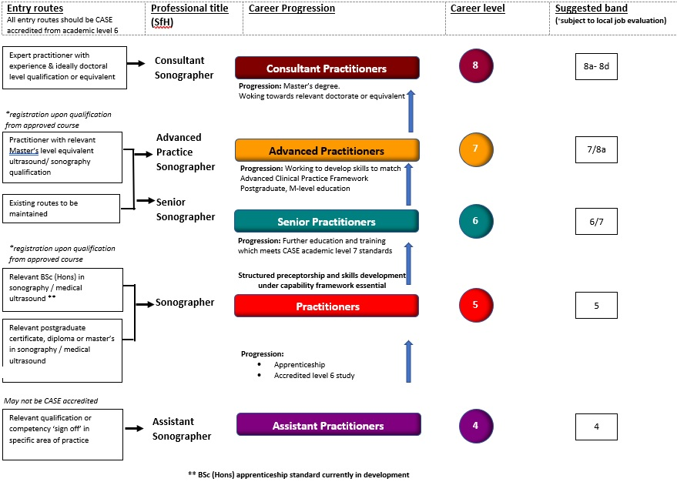
Proposed career and progression framework for Sonography

Slide 11

Working groups - SIG: Scope of practice

Slide 12
Career Level | Scope
4 | Practice is highly focussed. Works to clearly defined protocols.
5 | Non-complex, non-urgent referrals with clear clinical history and clinical question. FASP to be supervised. Reports: normal – standardised report. Abnormal – reviewed to provide interpretative report
6 | Obstetrics range of cases incl. EPU cases; DQASS number given by FASP following capability development period Gynaecology: GP and Hospital cases, as competencies develop General medical: GP and Hospital cases, as competencies develop Abdominal and pelvic scans Surveillance scans e.g. AML, haemangioma, ovarian and uterine pathology, orchitis Vascular: DVT (above knee); Carotid assessment (disease to be graded by L7 practitioner or above) Areas of practice develop over time. Clear schemes of work
7 | A wide range of examinations will be performed independently, including more complex and acute cases from a broad range of referral sources. As skills and competency develop, additional scope of practice might include: Follow-up scans post CT / MRI in complex cases Musculoskeletal scans and steroid injections CEUS examinations Interventional procedures such as biopsy, drainages, amniocentesis, FNAB Sonographer led discharge
8 | Independently manages a complex case load. May influence service improvements and redesign. Is active in research and publication, consultancy and national policy development and dissemination.

Slide 13
 | Scope
4 | Practice is highly focussed. Works to clearly defined protocols.
5 | Non-complex, non-urgent referrals with clear clinical history and clinical question. FASP to be supervised. Reports: normal – standardised report. Abnormal – reviewed to provide interpretative report
6 | Obstetrics range of cases incl. EPU cases; DQASS number given by FASP following capability development period Gynaecology: GP and Hospital cases, as competencies develop General medical: GP and Hospital cases, as competencies develop Abdominal and pelvic scans Surveillance scans e.g. AML, haemangioma, ovarian and uterine pathology, orchitis Vascular: DVT (above knee); Carotid assessment (disease to be graded by L7 practitioner or above) Areas of practice develop over time. Clear schemes of work
7 | A wide range of examinations will be performed independently, including more complex and acute cases from a broad range of referral sources. As skills and competency develop, additional scope of practice might include: Follow-up scans post CT / MRI in complex cases Musculoskeletal scans and steroid injections CEUS examinations Interventional procedures such as biopsy, drainages, amniocentesis, FNAB Sonographer led discharge
8 | Independently manages a complex case load. May influence service improvements and redesign. Is active in research and publication, consultancy and national policy development and dissemination.
 | Progression
4 | CASE level 6 award Pg course (if already has BSc)
5 | Structured preceptorship Capability development – formal programme to support development to autonomous practice L7 course to get wider skills (leadership, communication, education, critical thinking etc)
6 | PgC or PgD e.g. a chosen clinical specialty advanced practice skills of reporting advanced communication extended pathophysiology Management / leadership ACP (if registered HCP)
7 | Will hold Pg qualification. Ideally MSc Undertakes Research Audit Education (wider) Practitioner development scheme Possibly working towards doctorate level qualification
8 | Clinical or management focussed education Holds MSc & ideally working towards / hold doctoral level qualification Active in audit, research relevant to service development and professional needs.

Slide 14
Working groups: SIG
Preceptorship
Capability Development Period
Existing Sonographers – the impact
of new career sonographers on the existing workforce will need to be considered and carefully taken into account
Advanced Clinical Practice Framework.
Working groups
SIG
STG
Regulation
NOS

Slide 15
Working groups: STG
Working groups
Ways to increase clinical capacity for
ultrasound training
SIG
STG
Regulation
NOS

Slide 16
Working groups: Regulation
Professional Standards Authority reviewing evidence & stakeholder group.
Drafting recommendations & final report to be delivered in early February 2019
HEE submit documentation to government for consideration
Working groups
SIG
STG
Regulation
NOS

Slide 17
Working groups: National Occupational Standards
Working groups
Skills for Health NOS for ultrasound examinations
“Describes the knowledge, skills and understanding an individual needs to be competent at a job.”
CASE standards …
SIG
STG
Regulation
NOS

Slide 18


CASE Standards
Your role: check mapping of programme /module LOs to CASE LOs & NOS
Standards for sonographic education at different levels
FHEQ
Level 6
BSc (Hons)
Competent, safe sonographer
Professional attributes for effective and empathetic care
Understand scope of practice, supervision and mentorship
Reflective practitioner. Responsive to patient and service needs.
Critically review evidence.
Skills to progress to the next level
Notes:
HEE commissioned a project to develop ‘Standards for Sonographic Education’ Looking at developing learning outcomes for L6 (BSc) & L7 (Pg)…took it one step further and included L8 (PhD level) to future proof the ultrasound ‘profession’.
L6 – A sonographer who is
Competent and safe with knowledge, understanding and ability to independently undertake, interpret, analyse and report U/S scan within their focused scope of practice, with appropriate supervision.
Professional attributes incl. 6 C’s (care, compassion, communication, commitment, competence and courage) to work effectively and empathetically with wide range of service users
Have thorough understanding of their scope of practice & the importance of working under supervision & mentorship of snr staff to develop personal, professional, clinical and research skills.
Safe, reflective practitioner, responsive to patient & service needs, with analytical and problem solving skills, the ability to critically review evidence and clinical practice and disseminated knowledge to others
Have comprehensive knowledge of how to evidence and develop their skills, knowledge, reporting practice and clinical competency to progress to the next level of practice.
supported by well-defined structured precenptorship

Slide 19

CASE Standards
Standards for sonographic education at different levels
FHEQ
Level 7
Post-graduate
Level 6 skills plus:
Manage complex case loads & situations
Communicate effectively, EBP, clinical decision making in a range of situations
After preceptorship & capability development period have ability to develop to fulfil role of ACP
Knowledge & ability to develop leadership and management skills, education and research

Slide 20
CASE Standards
FHEQ
Level 8
Doctoral level
Expert clinical practitioner in complex, unpredictable environments
Contribute to effective team-working, MDT
Communicate to influence policy makers and inform future direction of profession
Innovation, education, leadership, research nationally & internationally
Notes:
HEE commissioned a project to develop ‘Standards for Sonographic Education’ Looking at developing learning outcomes for L6 (BSc) & L7 (Pg)…took it one step further and included L8 (PhD level) to future proof the ultrasound ‘profession’.
L6 – A sonographer who is
Competent and safe with knowledge, understanding and ability to independently undertake, interpret, analyse and report U/S scan within their focused scope of practice, with appropriate supervision.
Professional attributes incl. 6 C’s (care, compassion, communication, commitment, competence and courage) to work effectively and empathetically with wide range of service users
Have thorough understanding of their scope of practice & the importance of working under supervision & mentorship of snr staff to develop personal, professional, clinical and research skills.
Safe, reflective practitioner, responsive to patient & service needs, with analytical and problem solving skills, the ability to critically review evidence and clinical practice and disseminated knowledge to others
Have comprehensive knowledge of how to evidence and develop their skills, knowledge, reporting practice and clinical competency to progress to the next level of practice.
supported by well-defined structured precenptorship

Slide 21
Course content: All options
Level 6
Demonstrate, understand, perform, critique
Level 7
Critical knowledge and developing leadership
Level 8
Leader in the field
Syllabus
Science & technology
Professional issues
Clinical skills and knowledge
Notes:
Students are university students not belonging the department, so many other issues to consider compared with programmes that recruit students with a HC background.
Students will have (presumed) no HC background, so will need all the basic introductory taught content such as mandatory training, generic educational skills incl. EBP, infection control, communication, cultural competence, professionalism, data protection, confidentiality
Development of skills
For programmes that are looking at DE along side programmes – clinical capacity is going to be a key factor in the consideration of programme approval / sustainability.

Slide 22
ACTIVITY 1: Focused v Pg programme?
Focused Courses
Specific limited area of clinical practice
Competent and safe to undertake, interpret, analyse and report focused ultrasound examinations in that defined area of clinical practice.
Achieve competence in a clearly defined set of skills that are a subset of those covered by a full CASE accredited module in that area.
Same clinical practice and academic standards as found in any full programme that CASE accredits.
PgC/D
Focused course: New skills
Focused course: extension of existing skills
a Focused Course should not be imported into a full ultrasound programme
http://www.case-uk.org/information/publications/focused-courses/

Slide 23
ACTIVITY 1:
Individually:
List all types of ultrasound practice that you can think of.
Separate the list into four columns
Group:
Compare and discuss
Focused course - new skill | Focused course – for existing practitioners | Pg programme e.g. PgC | Unsure
e.g.
AAA screening | MSK joint injections | Abdominal ultrasound

Slide 24
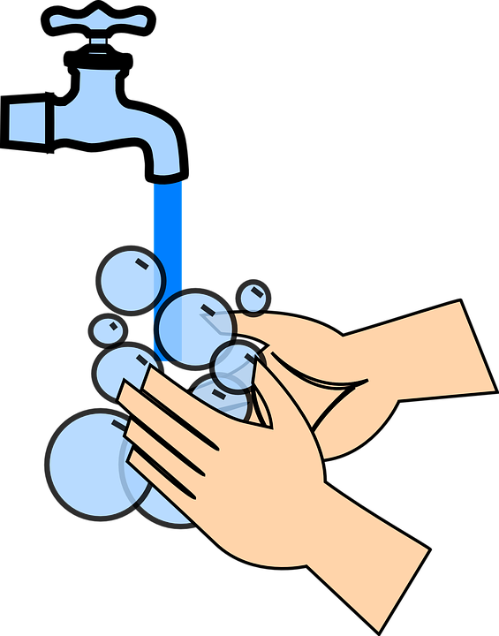
ACTIVITY 2: What additional things need to be considered for direct entry ultrasound?
Direct Entry
Selection process
Extent & limits of role
Basic skills & knowledge
- uniform policy
Simulation & clinical skills
Clinical capacity
- links / progress monitoring
Regulation (lack of)
Notes:
Students are university students not belonging the department, so many other issues to consider compared with programmes that recruit students with a HC background.
Students will have (presumed) no HC background, so will need all the basic introductory taught content such as mandatory training, generic educational skills incl. EBP, infection control, communication, cultural competence, professionalism, data protection, confidentiality
Development of skills
For programmes that are looking at DE along side programmes – clinical capacity is going to be a key factor in the consideration of programme approval / sustainability.

Slide 25
Conclusion
Changes within ultrasound education need clear, streamlined processes.
CASE need to ensure rigorous review of programmes and courses to ensure patient safety.
Accreditors need to be aware of the differences between focused courses and Pg programmes.

Slide 26
CASE documents and processes
Available at:
http://www.case-uk.org/

