Slide 1

Gill Harrison
CASE Committee member, lead accreditor, education lead
Associate Professor & Ultrasound Programme Director. City, University of London

Slide 2

Assessing Clinical Competency
Aims
Review CASE requirements for clinical assessments
Consider how to review clinical assessment schemes
Discuss challenges

Slide 3
ACTIVITY: What are the most important aspects to consider when reviewing clinical elements

Slide 4
Key issues should include
“To ensure rigorous and equitable assessment of student’s/trainee’s clinical abilities, ensure protection of the public and reduce bias, CASE expects at least one of the summative clinical assessments, for each module or clinical area, to be moderated by an external assessor/moderator who is not directly responsible for the students’ training”
(CASE Handbook, p.56)
CASE criteria (handbook)
Formative monitoring
Liaison with clinical teams
Mentor/assessor training
Summative assessments – min requirements met
Clear documentation / assessment forms
Pass/fail assessment
Moderation of assessments

Slide 5
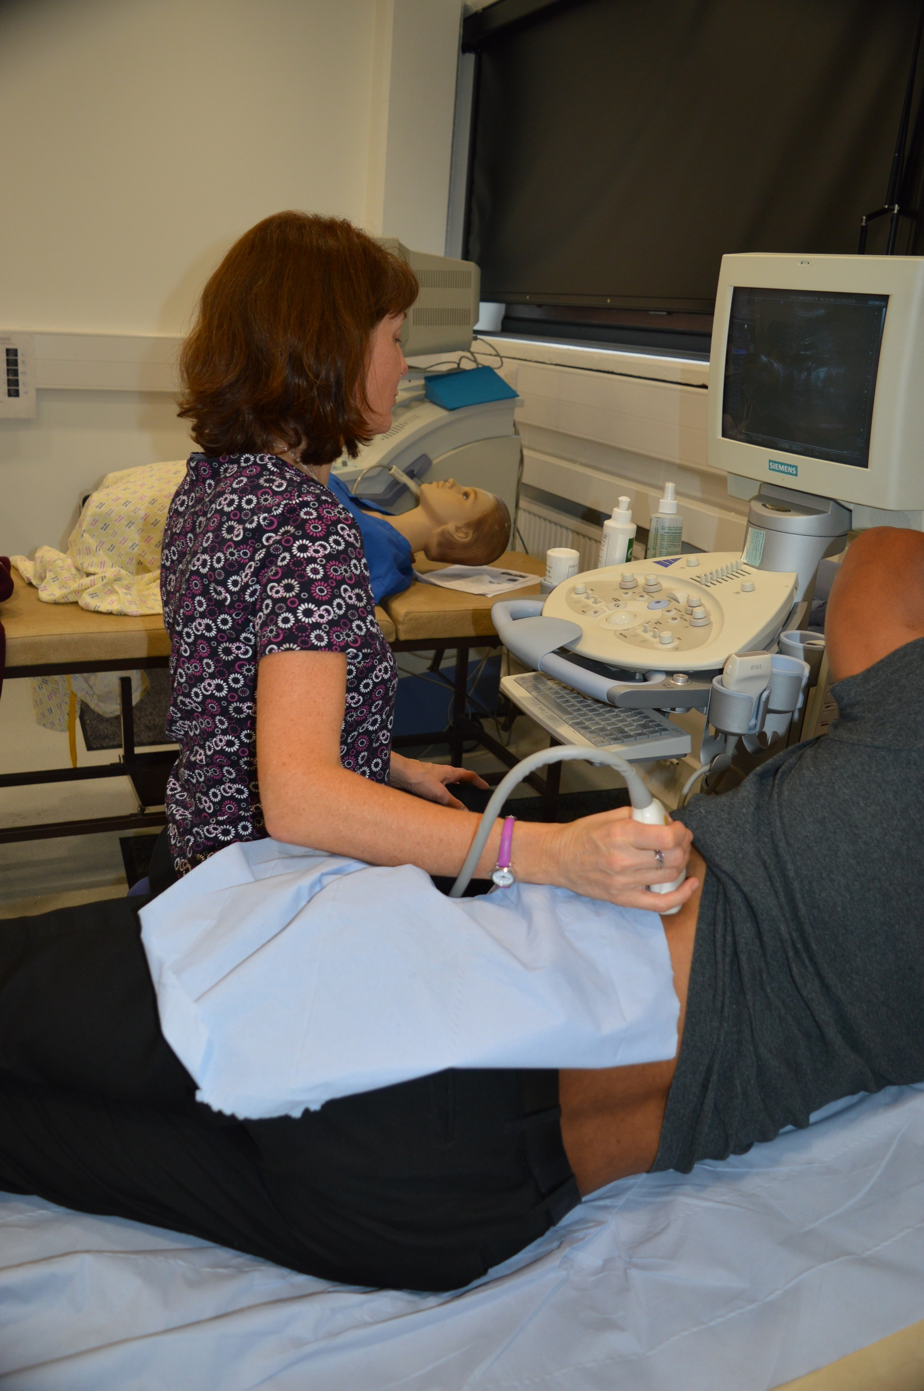
ACTIVITY: Review the clinical assessment documents and provide key issues that might be discussed with the programme team, clinical assessors and/ or students at an accreditation event.

Slide 6

Clinical capacity

Slide 7
HEE work: STG
Limited clinical capacity
New solutions:
?academy
?peripatetic educators
How to monitor quality and consistency of learning experience?
Sonography Training Group

Slide 8
Conclusion
Clinical competency assessment one of the most important aspects of CASE accreditation.
Need robust, fair and consistent processes = diligence
Innovation is encouraged.
Need to review & map to CASE requirements
Triangulation = faculty, students, clinical
Be strong, collaborative and consistent

Slide 9
CASE documents and processes
Available at:
http://www.case-uk.org/

