Slide 1


CASE Clinical Advisory role and support
Heather Venables
Nov 2021

Slide 2

Aims for this session
Explore what we mean by a Clinical Advisor and what would be expected
Consider why this role may help support course accreditation
Discuss development of this role and support needs

Slide 3

CASE accreditors
Who are we and who does what?

Slide 4
Academic
Clinical
Clinical-academic
Physicist

Slide 5
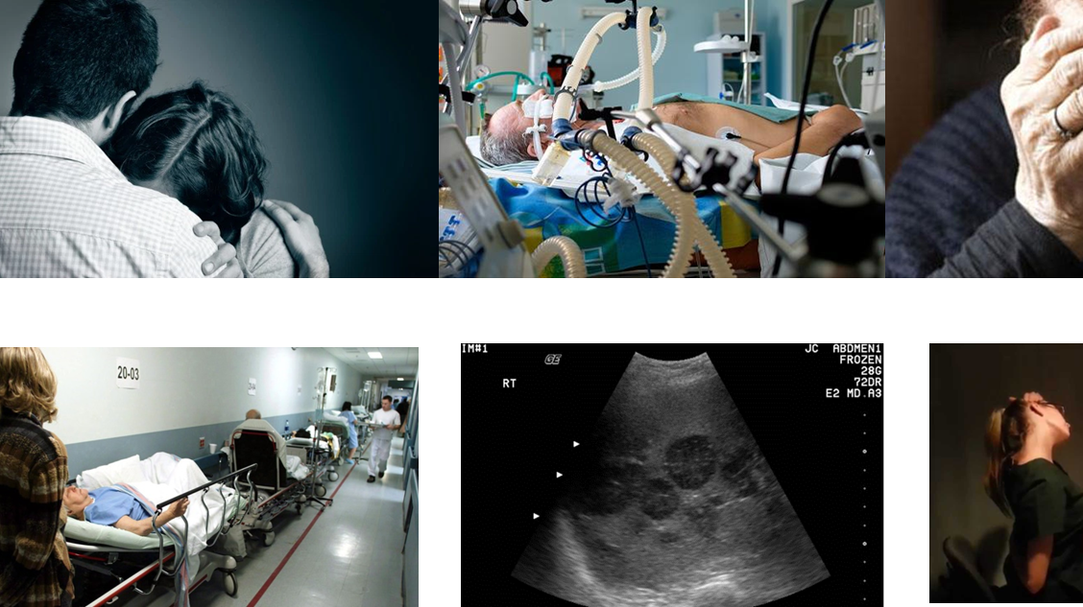
CASE Accreditation is not just about academic rigor
Essential to ensure currency, relevance to practice and future service needs

Slide 6
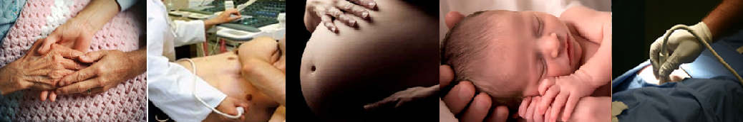
General Medical Gynaecology Early Pregnancy Fertility Trauma Obstetric screening Musculoskeletal Interventional Head and Neck Paediatrics Vascular Shock Cardiac Breast Podiatry Fetal Medicine

Slide 7
Principles of CASE course accreditation
Central to all accreditation decisions must be our commitment to promoting safe and effective diagnostic ultrasound practice.
Include learning outcomes that are linked explicitly to a defined ScoP
Include assessment of theoretical and practical elements that reflect best practice (rather than minimal competence) and are achievable within the proposed structure (including placement support).
Flexibility and innovation in content and delivery are to be encouraged. However, this must not be at the expense of patient safety.

Slide 8
Academic or clinical expert?
What do we need to consider…?

Slide 9
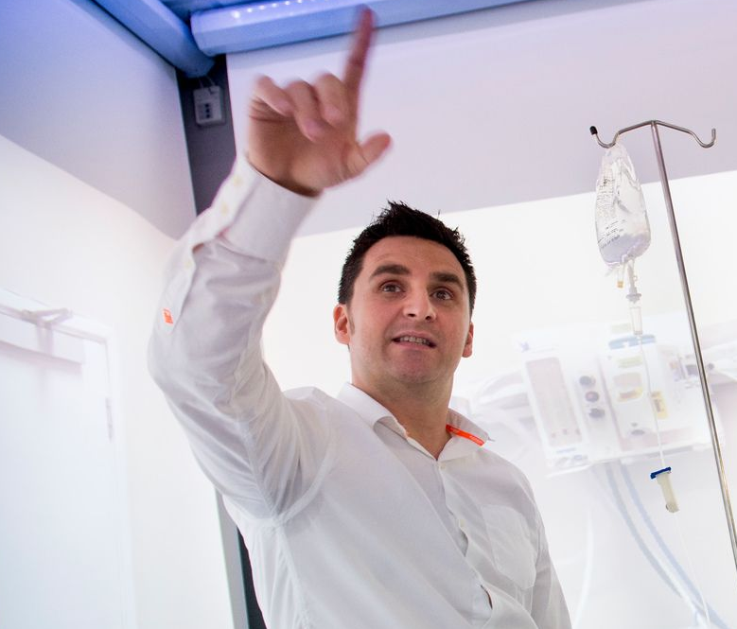

What do current accreditors think…?
“Clinical people don’t have the insight we need in HEI”
“Lead Accreditors should have a very good knowledge of HEIs”
“I have been out of clinical practice for a while… “
“I would like to be a co-accreditor but I think I lack the (HEI) experience to be a lead. Not sure if I want to aim for this.”
“I’m clinical …so feel a bit out of touch with academia”
“Release from clinical can be difficult.” “I don’t have time to commit to a full accreditation event”
Notes:
Feedback from 1:1 interviews 2021

Slide 10
How would a clinical advisory role help…?

Slide 11
Shadow
Co-accreditor
Lead accreditor

Slide 12
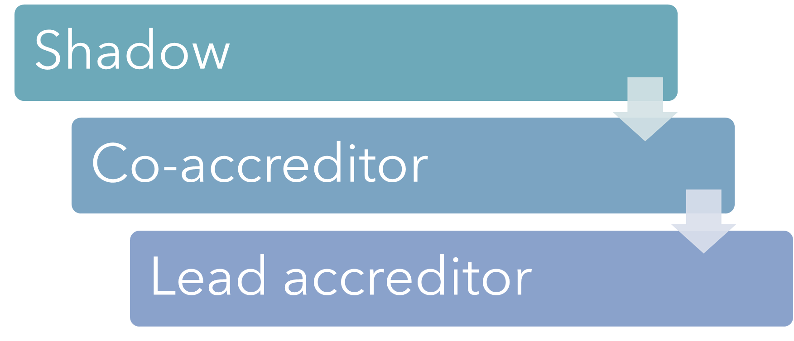
Clinical advisor
?
Expert insight
Current specialist clinical experience
Practice awareness
Future & emerging service needs
Notes:
What would they offer?

Slide 13
CASE represents 7 professional bodies
Breadth of practice is extensive and continues to grow

Slide 14
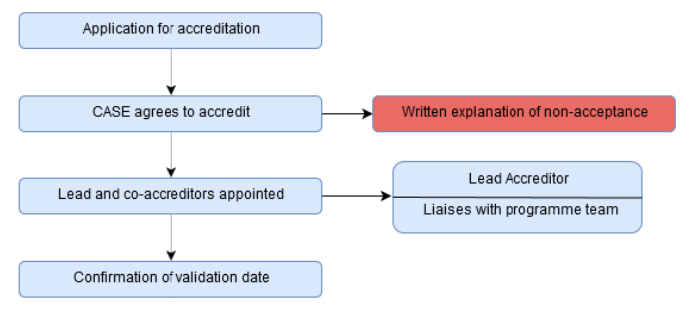
Current CASE accreditation process
Clinical Advisors identified

Slide 15
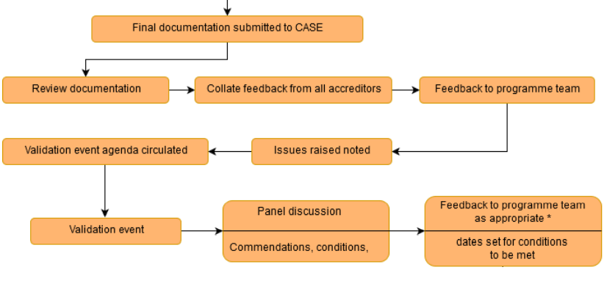
Current CASE accreditation process
Clinical Advisor input
Notes:
Refer back to clinical advisory group as needed.

Slide 16
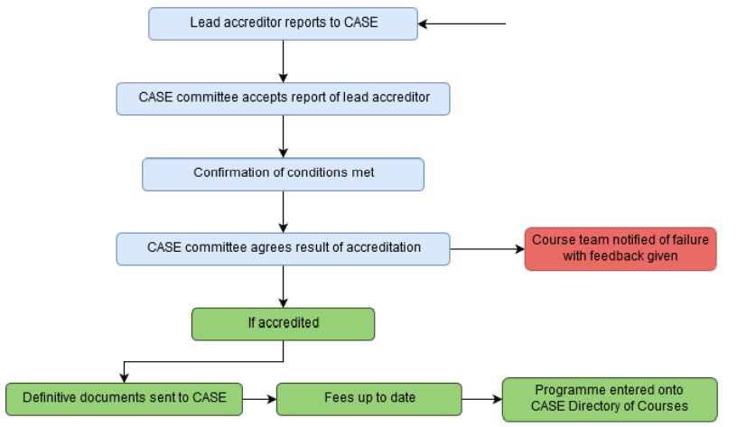
Current CASE accreditation process

Slide 17
Clinical advisor
Initial document review
Virtual discussion with accreditation team
Expert advice where needed
Minimal paperwork
No need to commit to a full event
Notes:
What would they offer?

Slide 18
Potential benefits…?
Robust approach to ensuring currency and meeting future service needs
Reflects the breadth of specialist ultrasound practice across CASE member organisations
Opportunity for expert influence from individuals who are unable to commit to full accreditor role
Builds a wider community of CASE champions
Helps to raise CASE profile within clinical communities
CPD opportunity - 4 pillars of ACP

Slide 19
Next steps…?

Slide 20

Any questions…?

